Slide 1
Praktikum Kecerdasan Buatan Algoritma Pencarian Breadth First Search dan Depth First Search
Dosen Pengampu Entin Martiana Kusumaningtyas S.Kom, M.kom
Ratri Maria Manik 3121600039 2 D4 IT - B

Slide 2
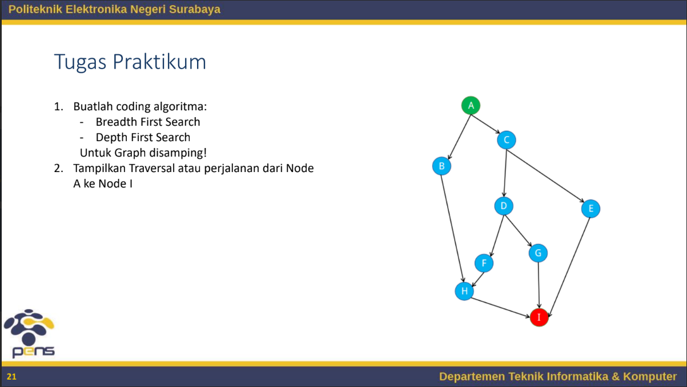
01

Slide 3
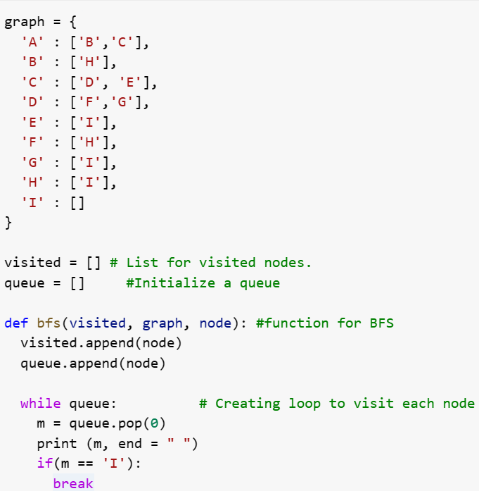
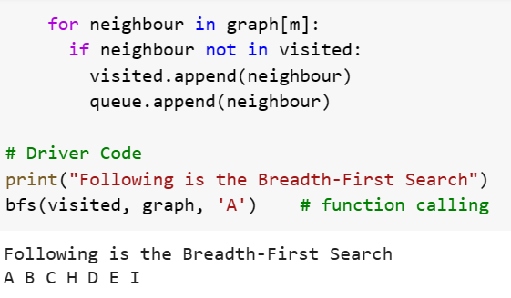
Breadth First Search

Slide 4
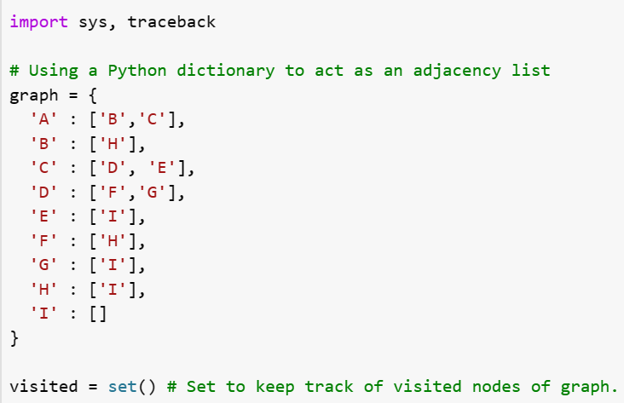
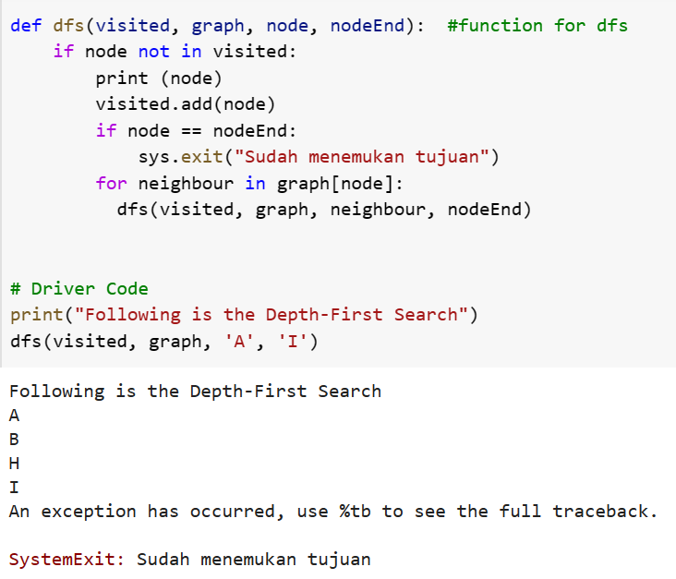
Depth First Search

Slide 5
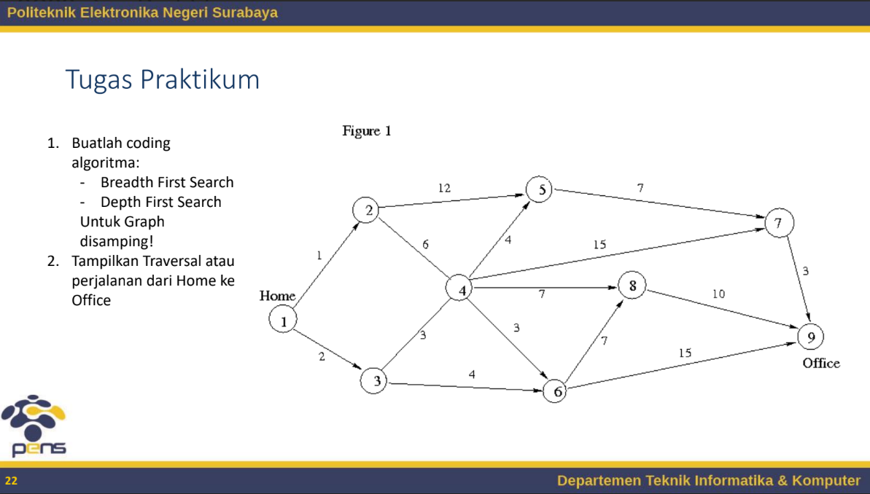
02

Slide 6
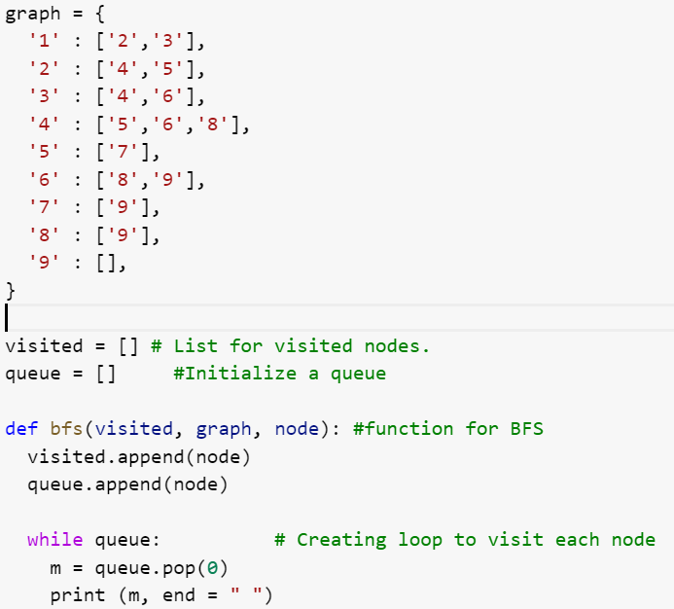
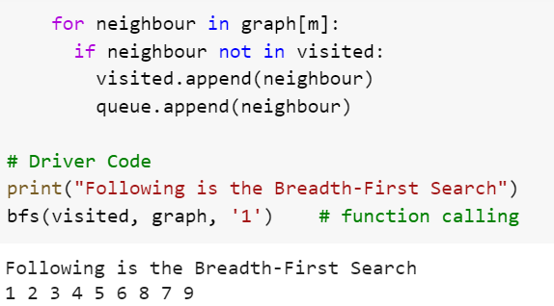
Breadth First Search

Slide 7
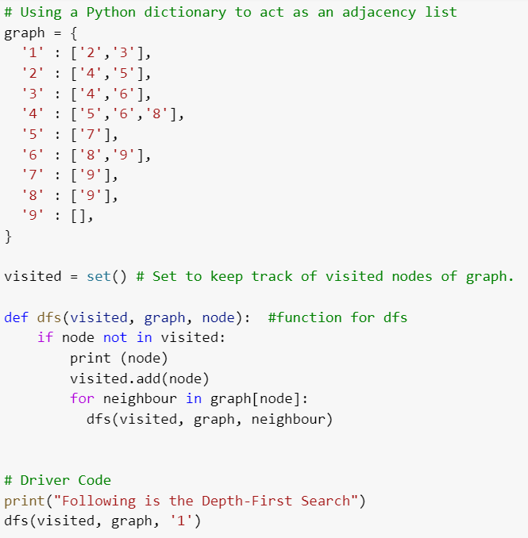
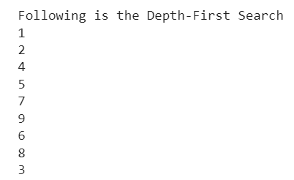
Depth First Search

Slide 8
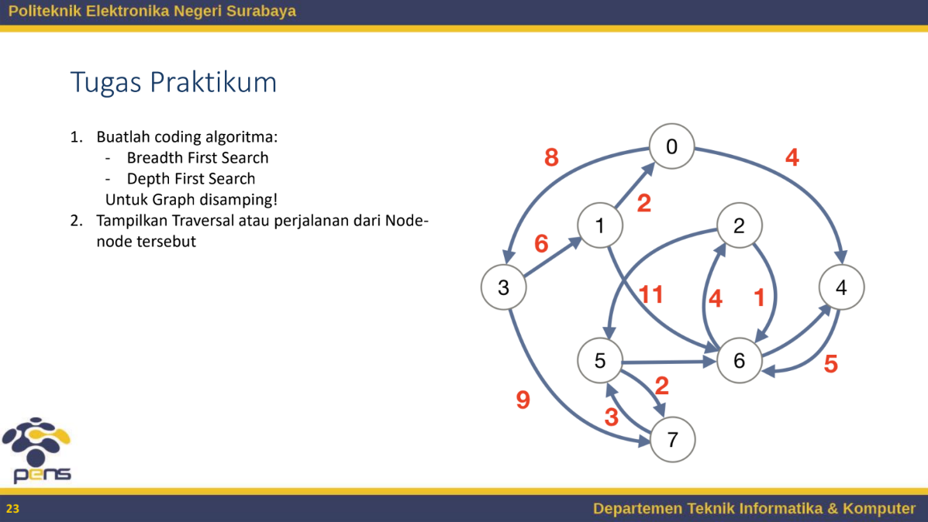
03

Slide 9
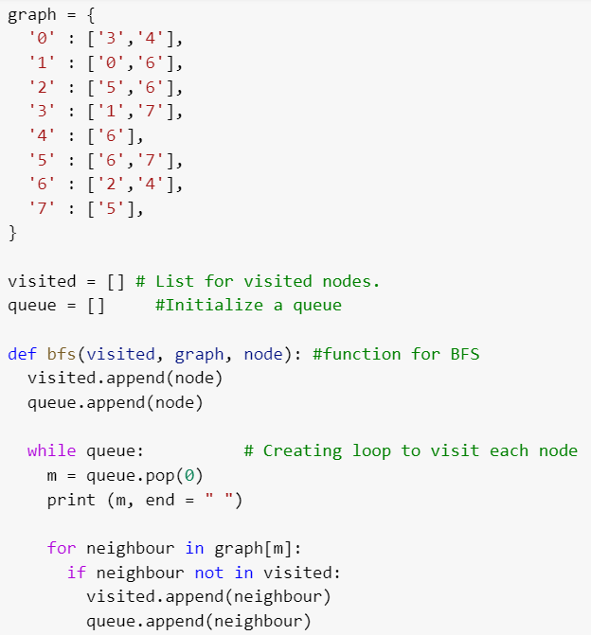

Breadth First Search

Slide 10
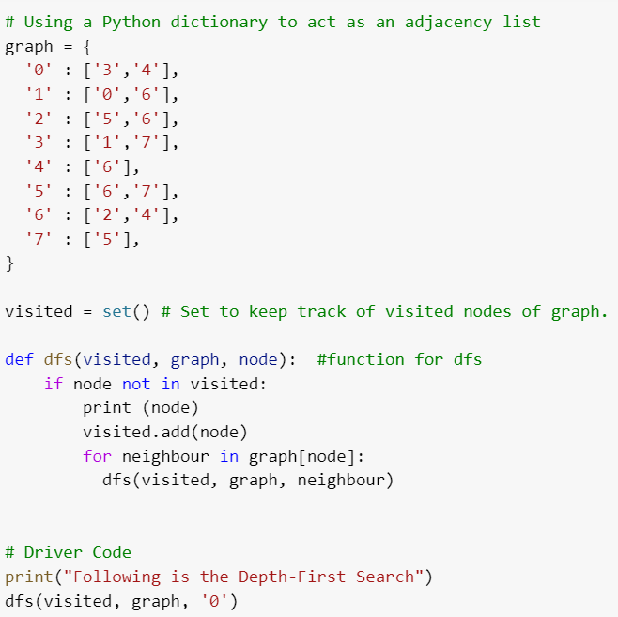
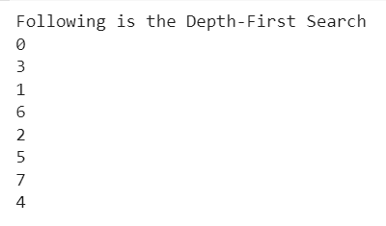
Depth First Search

